Slide 1
Arnes Housing Dataset

Slide 2
What contributes to House prices?
There are many things that can affect House prices.
Size
Having a Pool
Neighboorhood
Etc.
But how do they interact with each other?
Which is more important?

Slide 3
Project 2 workflow
Clean Training Dataset
EDA
Feature Engineer
Model 1
Reduce features
Model 2

Slide 4
Clean Training Dataset
Import data
For some columns ‘NA’ was a valid response. Hence, ‘NA’ was imported as they were and non as Nan
Fill in missing data
Most columns were filled with either 0 or ‘NA’ depending on the datatype of the column
Lot frontage was filled with its median value

Slide 5
Clean Training Dataset
Remove rows with too much missing data
Some rows had missing data on multiple columns. They were dropped
Remove outliers
Gr_living_area above 40000 was removed

Slide 6
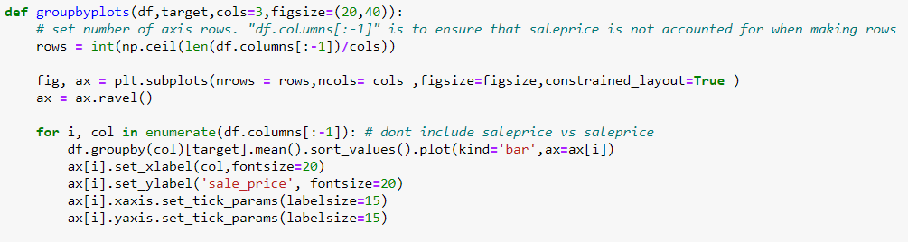
EDA
Compare sales prices of houses to features
Comparisons were done for categorical and non categorical values
Graphs were plotted against sales price to show its strength as a predictor

Slide 7
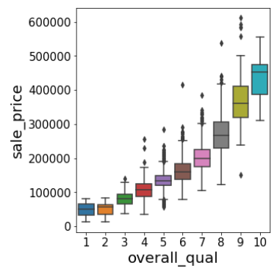
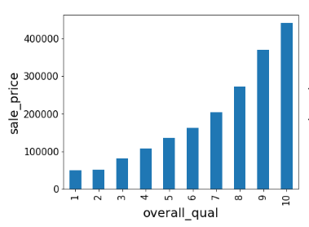
EDA - Categorical Variables
A groupby plot was made to compare the mean sale price for each category and a box plot was made to compare the range of prices within each category.

Slide 8
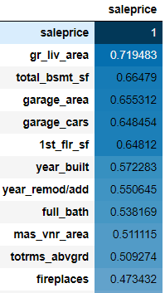
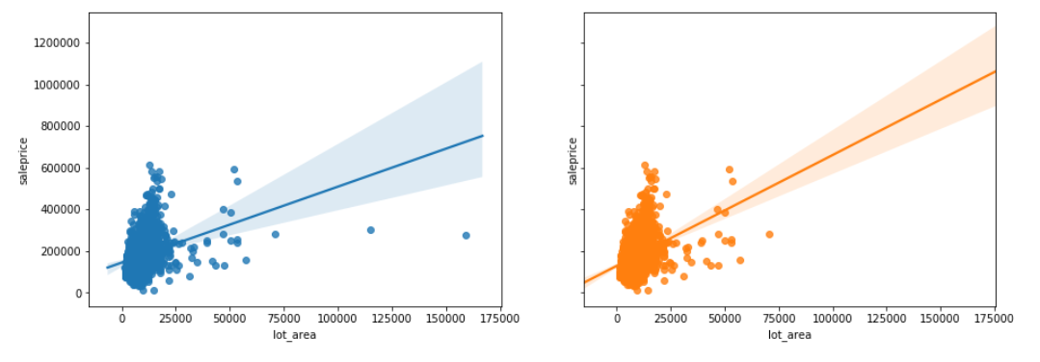
EDA - Numeric Variables
The correlations between he variables and sales prices were compared.
However, outliers were observed when plotting the graphs.
They were removed and a new graph was plotted to observe the changes

Slide 9
Feature Engineering
Change Categorical Variables into Numeric Variables
Ordinal
Nominal

Slide 10
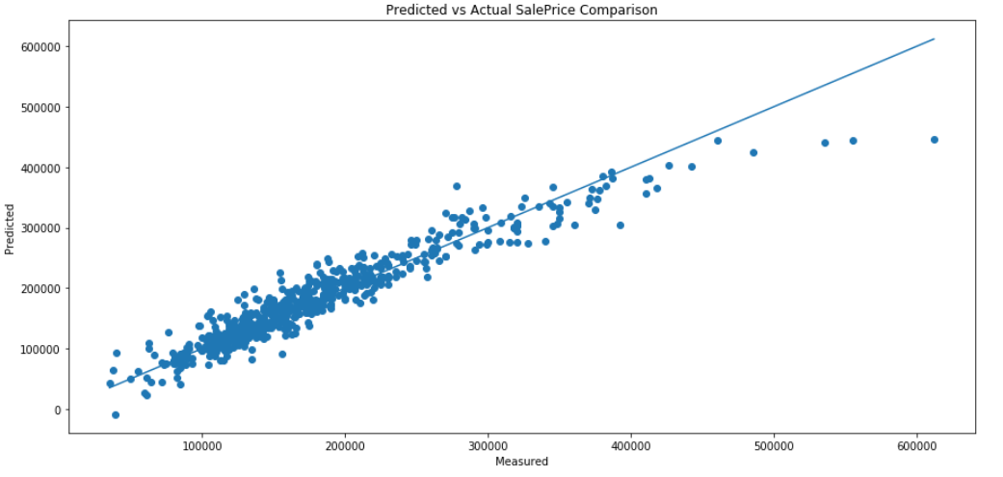
1st Model
Lasso Regression used to fit 209 variables
Lasso regression was used to reduce variables
R square of 0.909 was achieve for Y_test

Slide 11
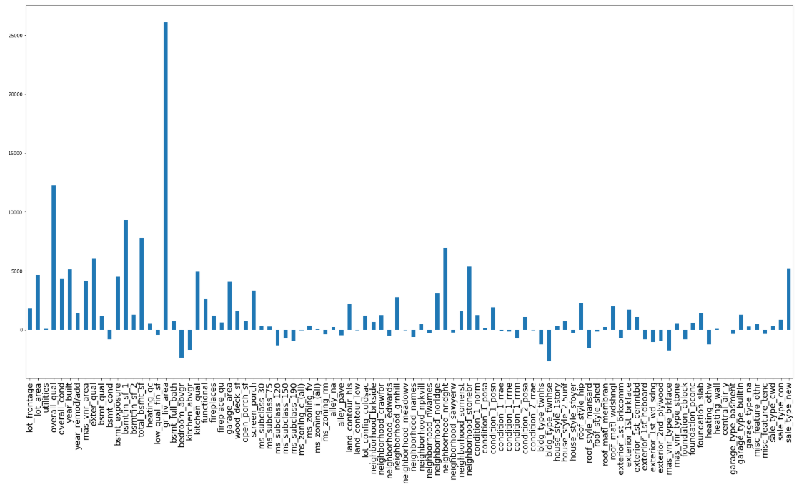
1st Model
Some features were much more responsible for the increase in price

Slide 12
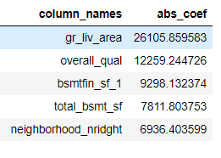
Reduce features
Too many features
Model performed decently but was too difficult to interpret
Decided to reduce to 25 features.
Picked 40 features from 1st model that increased sale price the most.

Slide 13
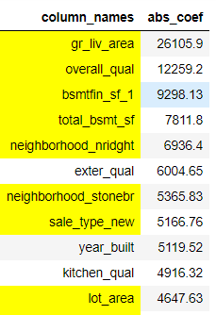
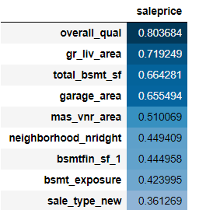
Reduce features
Picked 25 top non-correlated features (<0.6) from the above.
Features were not selected if they were correlated with each other
Compared against sales price

Slide 14
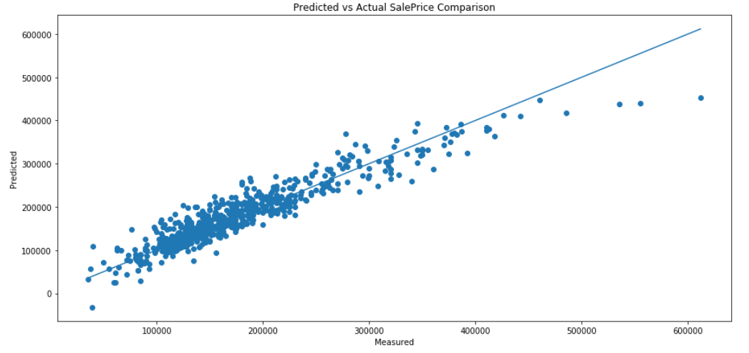
2nd Model
Ridge Regression used
R square of 0.877 achieved.

Slide 15
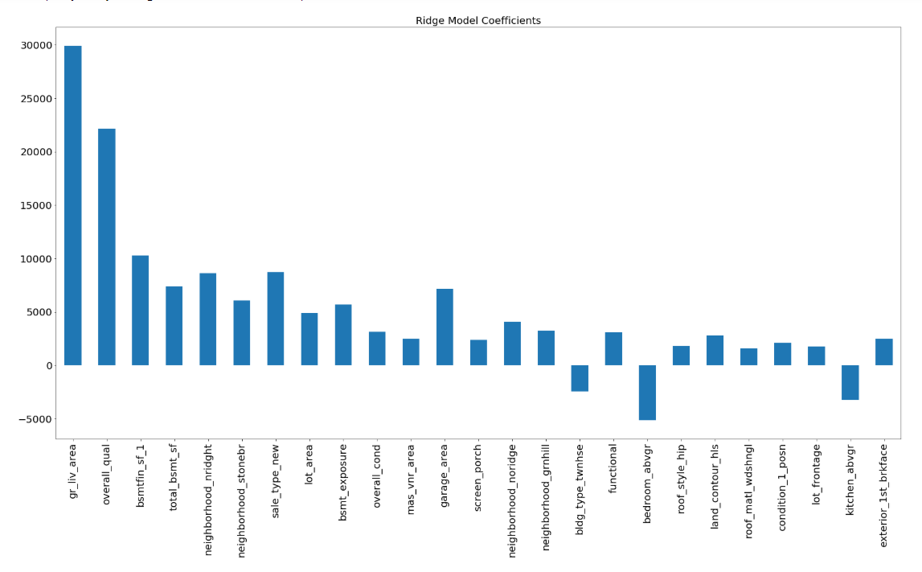
2nd Model
Gr _liv area and overall quality most responsible for prices

Slide 16
Conclusion
Model was able to predict score on kaggle to a certain extent
RSME 29k
First Model was better than Second Model, but too many features.
Perhaps a model with 40+ features would be more accurate
How missing data was dealt with also may make a difference.

